Slide 1
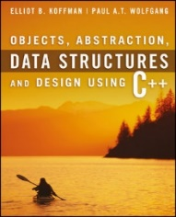
Welcome to
CS 235 Data Structures
Sorting (37)
Chapter 10.8-9, pgs. 599-614

Slide 2
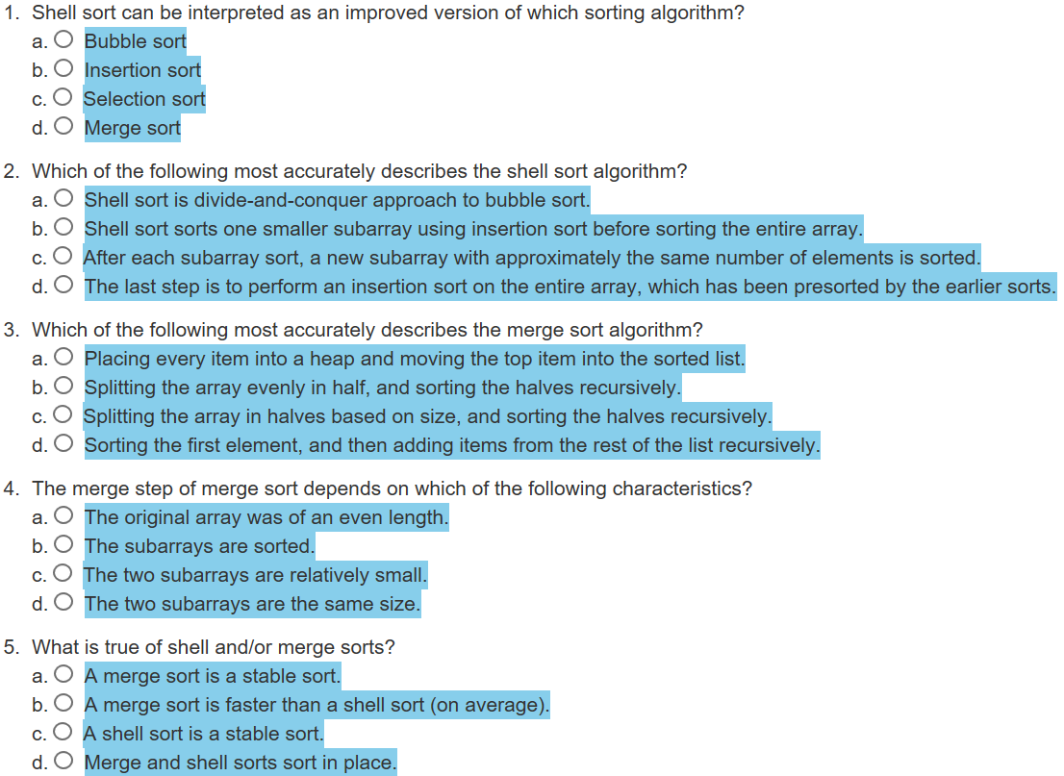
Attendance Quiz #36

Slide 3
Tip #37: Algorithms vs Loops
Every algorithm takes at least one pair of iterators.
For algorithms to work, they must examine every object in the range(s) they are passed - internally, algorithms are loops.
For many C++ programmers, writing the loop is more natural than calling the algorithm with an iterator, but calling an algorithm is usually preferable to any hand-written loop. Why?
Efficiency: Algorithms are often more efficient that loops programmers produce.
Container implementations optimize traversals because they know what's happening inside and eliminate redundant computations.
Correctness: Writing loops is more subject to errors than is calling algorithms.
At best, for, while, or do loops still require examination of the loop – algorithms do not!
Maintainability: Algorithm calls often yield code that is clearer and more straightforward than the corresponding explicitly loops.
Algorithm names are more meaningful that bare loops.
If you need to do something an algorithm already does, the algorithm call is clearer.
Replacing low-level words like for, while, and do with higher-level terms like insert, find, and for_each, raises the level of abstraction and thereby makes it easier to write, document, enhance, and maintain software.

Slide 4
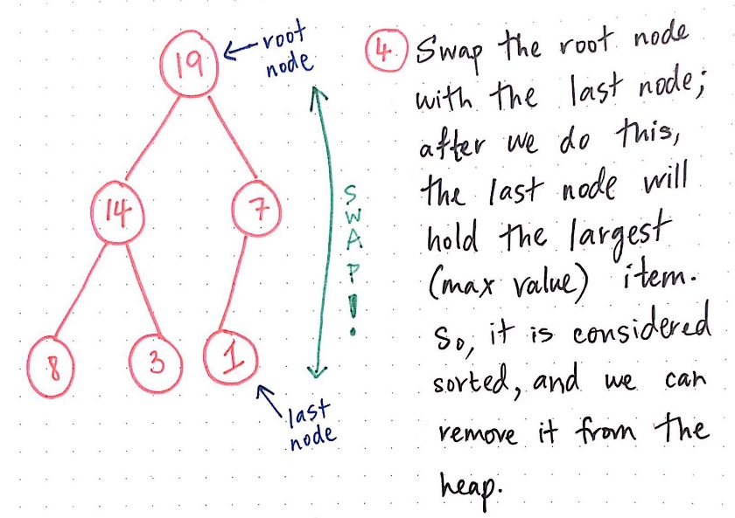
10.8 Heapsort
Heapsort Algorithm
Algorithm to Build a Heap
Analysis of Heapsort Algorithm
Code for Heapsort
10.8, pgs. 599-601

Slide 5
Heapsort
Merge sort time is O(n log n), but still requires, temporarily, n extra storage locations.
Heapsort is also O(n log n), but does not require any additional storage.
A max heap is used as its data structure with the largest value at the top.
Once we have a heap, we can remove one item at a time from the heap and place it at the bottom of the heap.
We then reheap by moving the larger of a node’s two children up the heap if needed, so the new heap will have the next largest item as its root.
As we continue to remove items from the heap, the heap size shrinks and the number of the removed items increases.
After we have removed the last element, the array will be sorted.

Slide 6
Heapsort
Max Heap?
Yes!
89
76
74
37
32
39
66
20
26
18
28
29
6

Slide 7
Heapsort
89
76
74
37
32
39
66
20
26
18
28
29
6

Slide 8
Heapsort
6
76
74
37
32
39
66
20
26
18
28
29
89

Slide 9
Heapsort
76
6
74
37
32
39
66
20
26
18
28
29
89

Slide 10
Heapsort
76
37
74
6
32
39
66
20
26
18
28
29
89

Slide 11
Heapsort
76
37
74
26
32
39
66
20
6
18
28
29
89

Slide 12
Heapsort
76
37
74
26
32
39
66
20
6
18
28
29
89

Slide 13
Heapsort
29
37
74
26
32
39
66
20
6
18
28
76
89

Slide 14
Heapsort
74
37
29
26
32
39
66
20
6
18
28
76
89

Slide 15
Heapsort
74
37
66
26
32
39
29
20
6
18
28
76
89

Slide 16
Heapsort
74
37
66
26
32
39
29
20
6
18
28
76
89

Slide 17
Heapsort
28
37
66
26
32
39
29
20
6
18
74
76
89

Slide 18
Heapsort
66
37
28
26
32
39
29
20
6
18
74
76
89

Slide 19
Heapsort
66
37
39
26
32
28
29
20
6
18
74
76
89

Slide 20
Heapsort
66
37
39
26
32
28
29
20
6
18
74
76
89

Slide 21
Heapsort
18
37
39
26
32
28
29
20
6
66
74
76
89

Slide 22
Heapsort
39
37
18
26
32
28
29
20
6
66
74
76
89

Slide 23
Heapsort
39
37
29
26
32
28
18
20
6
66
74
76
89

Slide 24
Heapsort
39
37
29
26
32
28
18
20
6
66
74
76
89

Slide 25
Heapsort
6
37
29
26
32
28
18
20
39
66
74
76
89

Slide 26
Heapsort
37
6
29
26
32
28
18
20
39
66
74
76
89

Slide 27
Heapsort
37
32
29
26
6
28
18
20
39
66
74
76
89

Slide 28
Heapsort
37
32
29
26
6
28
18
20
39
66
74
76
89

Slide 29
Heapsort
20
32
29
26
6
28
18
37
39
66
74
76
89

Slide 30
Heapsort
32
20
29
26
6
28
18
37
39
66
74
76
89

Slide 31
Heapsort
32
26
29
20
6
28
18
37
39
66
74
76
89

Slide 32
Heapsort
32
26
29
20
6
28
18
37
39
66
74
76
89

Slide 33
Heapsort
18
26
29
20
6
28
32
37
39
66
74
76
89

Slide 34
Heapsort
29
26
18
20
6
28
32
37
39
66
74
76
89

Slide 35
Heapsort
29
26
28
20
6
18
32
37
39
66
74
76
89

Slide 36
Heapsort
29
26
28
20
6
18
32
37
39
66
74
76
89

Slide 37
Heapsort
18
26
28
20
6
29
32
37
39
66
74
76
89

Slide 38
Heapsort
28
26
18
20
6
29
32
37
39
66
74
76
89

Slide 39
Heapsort
28
26
18
20
6
29
32
37
39
66
74
76
89

Slide 40
Heapsort
6
26
18
20
28
29
32
37
39
66
74
76
89

Slide 41
Heapsort
26
6
18
20
28
29
32
37
39
66
74
76
89

Slide 42
Heapsort
26
20
18
6
28
29
32
37
39
66
74
76
89

Slide 43
Heapsort
26
20
18
6
28
29
32
37
39
66
74
76
89

Slide 44
Heapsort
6
20
18
26
28
29
32
37
39
66
74
76
89

Slide 45
Heapsort
20
6
18
26
28
29
32
37
39
66
74
76
89

Slide 46
Heapsort
20
6
18
26
28
29
32
37
39
66
74
76
89

Slide 47
Heapsort
18
6
20
26
28
29
32
37
39
66
74
76
89

Slide 48
Heapsort
18
6
20
26
28
29
32
37
39
66
74
76
89

Slide 49
Heapsort
6
18
20
26
28
29
32
37
39
66
74
76
89

Slide 50
Heapsort
6
18
20
26
28
29
32
37
39
66
74
76
89

Slide 51
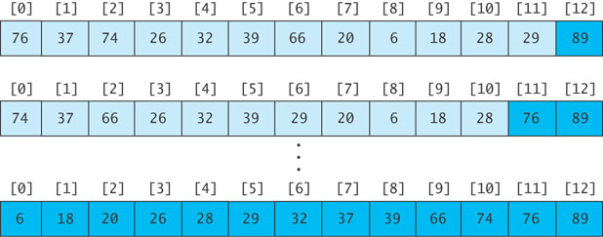
Revising the Heapsort Algorithm
If we implement the heap as an array
each element removed will be placed at the end of the array, and
the heap part of the array decreases by one element

Slide 52
Algorithm for In-Place Heapsort
Build a heap by rearranging the elements in an unsorted array.
1.1 while n is less than table.length
1.2 Increment n by 1. This inserts a new item into the heap
1.3 Restore the heap property
while the heap is not empty
Remove the first item from the heap by swapping it with the last item in the heap and restoring the heap property

Slide 53
Analysis of Heapsort
If we want to sort the sequence table bounded by the iterators first through last, we can consider the first item to be a heap of one item
We now consider the general case where the items in the sequence from table[first] through table[first + n - 1] form a heap;
Items from table[first + n] through table[last – 1] are not in the heap.
As each item is inserted, we must “reheap” to restore the heap property.
Because a heap of size n is a complete binary tree, it has log n levels
Building a heap requires finding the correct location for an item in a heap with log n levels
Each insert (or remove) is O(log n)
With n items, building a heap is O(n log n)
No extra storage is needed.

Slide 54
Code for Heapsort
#ifndef HEAPSORT_H_
#define HEAPSORT_H_
#include <algorithm>
/** Sort data in the specified range using heapsort. */
template<typename RI>
void heap_sort(RI first, RI last)
{
build_heap(first, last);
shrink_heap(first, last);
}
/** build_heap transforms the sequence into a heap. */
template<typename RI>
void build_heap(RI first, RI last)
{
int n = 1;
// Invariant: table[first] through table[first + n - 1] is a heap.
while (n < (last - first))
{
++n; // Add a new item to the heap and reheap.
RI child = first + n - 1;
RI parent = first + (child - first - 1) / 2; // Find parent.
while ((parent >= first) && (*parent < *child))
{
std::iter_swap(parent, child); // Exchange elements.
child = parent;
parent = first + (child - first - 1) / 2;
}
}
}

Slide 55
Code for Heapsort
/** shrink_heap transforms a heap into a sorted sequence. */
template<typename RI>
void shrink_heap(RI first, RI last)
{
RI n = last;
/* Invariant: [first] - [first + n - 1] is a heap. [first + n] - [last - 1] is sorted. */
while (n != first)
{
--n;
std::iter_swap(first, n); // swap top and last of heap
RI parent = first;
while (true)
{
int temp = 2 * (parent - first) + 1;
if (temp >= (n - first)) break; // No more children.
RI left_child = first + temp;
RI right_child = left_child + 1;
// Find the larger of the two children.
RI max_child = left_child;
if ((right_child < n) && (*left_child < *right_child)) max_child = right_child;
if (*parent < *max_child) // If the parent is smaller than the larger child
{
std::iter_swap(parent, max_child); // Swap the parent and child.
parent = max_child; // Continue at the child level.
}
else break; // Heap property is restored. Exit the loop.
}
}
}
#endif

Slide 56
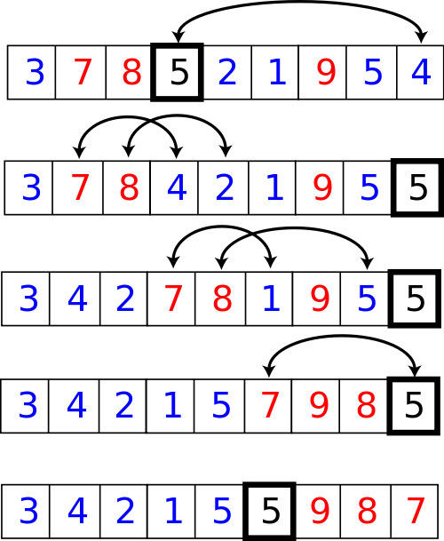
10.9 Quicksort
Algorithm for Quicksort
Code for Quicksort
Algorithm for Partitioning
Code for partition
A Revised Partition Algorithm
Code for Revised partition Function
10.9, pgs. 604-614

Slide 57
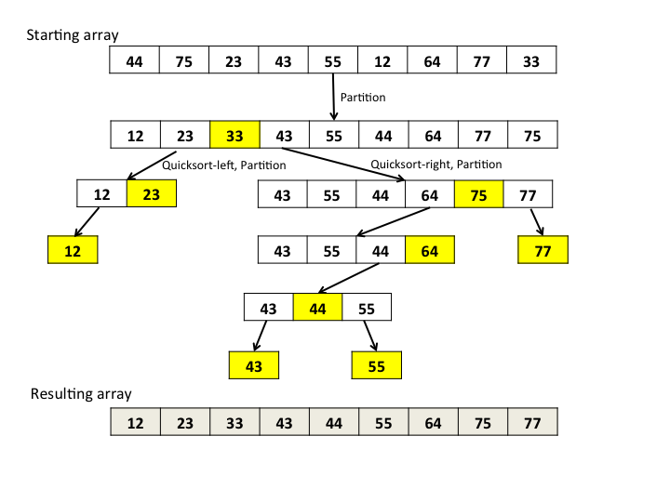
Quicksort
Developed in 1962.
Quicksort selects a specific value called a pivot and rearranges the array into two parts (called partitioning).
All the elements in the left subarray are less than or equal to the pivot.
All the elements in the right subarray are larger than the pivot.
The pivot is placed between the two subarrays.
The process is repeated until the array is sorted.

Slide 58
Quicksort Example
44
75
23
43
55
12
64
77
33

Slide 59
Quicksort Example
44
75
23
43
55
12
64
77
33
Arbitrarily select the first element as the pivot

Slide 60
Quicksort Example
55
75
23
43
44
12
64
77
33
Swap the pivot with the element in the middle

Slide 61
Quicksort Example
55
75
23
43
44
12
64
77
33
Partition the elements so that all values less than or equal to the pivot are to the left, and all values greater than the pivot are to the right

Slide 62
Trace of Quicksort
44 is now in its correct position
12
33
23
43
44
55
64
77
75
Partition the elements so that all values less than or equal to the pivot are to the left, and all values greater than the pivot are to the right
Now apply quicksort recursively to the two subarrays

Slide 63
Quicksort Example
Pivot value = 12
12
33
23
43
44
55
64
77
75

Slide 64
Quicksort Example
Pivot value = 12
12
33
23
43
44
55
64
77
75

Slide 65
Quicksort Example
Pivot value = 33
12
33
23
43
44
55
64
77
75

Slide 66
Quicksort Example
Pivot value = 33
12
23
33
43
44
55
64
77
75

Slide 67
Quicksort Example
Pivot value = 33
12
23
33
43
44
55
64
77
75
Left and right subarrays have single values; they are sorted

Slide 68
Quicksort Example
Pivot value = 33
12
23
33
43
44
55
64
77
75
Left and right subarrays have single values; they are sorted

Slide 69
Quicksort Example
Pivot value = 55
12
23
33
43
44
55
64
77
75

Slide 70
Quicksort Example
Pivot value = 64
12
23
33
43
44
55
64
77
75

Slide 71
Quicksort Example
Pivot value = 77
12
23
33
43
44
55
64
77
75

Slide 72
Quicksort Example
Pivot value = 77
12
23
33
43
44
55
64
75
77

Slide 73
Quicksort Example
12
23
33
43
44
55
64
75
77
Left subarray has single value; it is sorted

Slide 74
Quicksort Example
12
23
33
43
44
55
64
75
77

Slide 75
Algorithm for Quicksort
We describe how to do the partitioning later…
The iterators first and last are the end points of the array being sorted.
pivot is a pointer to the pivot value after partitioning.
Algorithm for Quicksort
if the sequence has more than one element:
Partition the elements in the sequence (from first through last) so that the pivot value is in its correct place and is pointed to by pivot.
Recursively apply quicksort to the sequence in the iterator range first through pivot.
Recursively apply quicksort to the sequence in the iterator range pivot + 1 through last

Slide 76
Analysis of Quicksort
If the pivot value is a random value selected from the current sequence,
then statistically, half of the items in the subarray will be less than the pivot and half will be greater.
If both subarrays have the same number of elements (best case), there will be log n levels of recursion.
At each recursion level, the partitioning process involves moving an element to its correct position—n moves.
Quicksort is O(n log n), just like merge sort.
A quicksort will give very poor behavior if, each time the array is partitioned, a subarray is empty.
In that case, the sort will be O(n²).
Further, the overhead of recursive calls and the extra run-time stack storage required by these calls makes this version of quicksort a poor performer relative to the quadratic sorts.

Slide 77
Quicksort Partitioning
44
75
23
43
55
12
64
77
33
If the array is randomly ordered, it does not matter which element is the pivot.
For simplicity we pick the element with subscript first

Slide 78
Quicksort Partitioning
44
75
23
43
55
12
64
77
33
If the array is randomly ordered, it does not matter which element is the pivot.
For simplicity we pick the element with subscript first

Slide 79
Quicksort Partitioning
44
75
23
43
55
12
64
77
33
For visualization purposes, items less than or equal to the pivot will be colored blue; items greater than the pivot will be colored light purple

Slide 80
Quicksort Partitioning
up
44
75
23
43
55
12
64
77
33
Search for the first value at the left end of the array that is greater than the pivot value

Slide 81
Quicksort Partitioning
up
44
75
23
43
55
12
64
77
33
Search for the first value at the left end of the array that is greater than the pivot value

Slide 82
Quicksort Partitioning
up
down
44
75
23
43
55
12
64
77
33
Then search for the first value at the right end of the array that is less than or equal to the pivot value

Slide 83
Quicksort Partitioning
up
down
44
75
23
43
55
12
64
77
33
Then search for the first value at the right end of the array that is less than or equal to the pivot value

Slide 84
Quicksort Partitioning
up
down
44
75
23
43
55
12
64
77
33
Exchange these values

Slide 85
Quicksort Partitioning
up
down
44
33
23
43
55
12
64
77
75
Exchange these values

Slide 86
Quicksort Partitioning
up
down
44
33
23
43
55
12
64
77
75
Repeat

Slide 87
Quicksort Partitioning
up
down
44
33
23
43
55
12
64
77
75
Find first value at left end greater than pivot

Slide 88
Quicksort Partitioning
up
down
44
33
23
43
55
12
64
77
75
Find first value at right end less than or equal to pivot

Slide 89
Quicksort Partitioning
up
down
44
33
23
43
12
55
64
77
75
Exchange

Slide 90
Quicksort Partitioning
up
down
44
33
23
43
12
55
64
77
75
Repeat

Slide 91
Quicksort Partitioning
up down
44
33
23
43
12
55
64
77
75
Find first element at left end greater than pivot

Slide 92
Quicksort Partitioning
down
up
44
33
23
43
12
55
64
77
75
Find first element at right end less than or equal to pivot

Slide 93
Quicksort Partitioning
down
up
44
33
23
43
12
55
64
77
75
Since down has "passed" up, do not exchange

Slide 94
Quicksort Partitioning
down
up
44
33
23
43
12
55
64
77
75
Exchange the pivot value with the value at down

Slide 95
Quicksort Partitioning
down
12
33
23
43
44
55
64
77
75
Exchange the pivot value with the value at down

Slide 96
Quicksort Partitioning
down
12
33
23
43
44
55
64
77
75
The pivot value is in the correct position!
Return the value of down and assign it to the iterator pivot

Slide 97
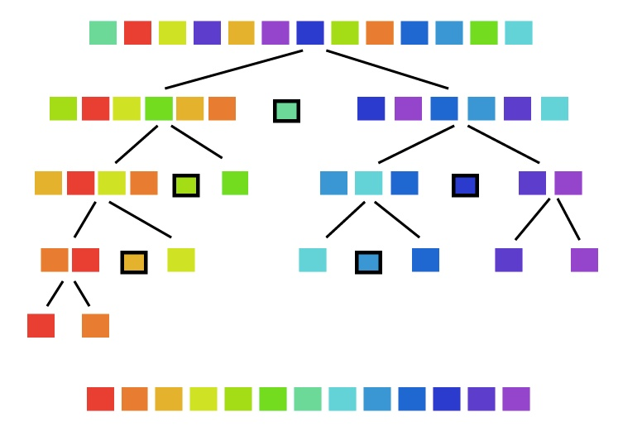
Lab 10 - Quicksort

Slide 98
Lab 10 - Quicksort
"Quicksort is a sorting algorithm developed by Tony Hoare that, on average, makes O(n log n) comparisons to sort n items. It is also known as partition-exchange sort.
In the worst case, Quicksort makes O(n²) comparisons, though this behavior is rare. Quicksort is typically faster in practice than other O(n log n) algorithms.
Additionally, quicksort's sequential and localized memory references work well with a cache. Quicksort can be implemented as an in-place partitioning algorithm."

Slide 99
Quicksort Commands
COMMAND | DESCRIPTION | OUTPUT
QuickSort <capacity> | Dynamically allocate a QuickSort array of size capacity. Set current number of elements (Size) to 0. | OK Error
AddToArray <data1> <data2>... | Add data element(s) to QuickSort array. Duplicates are allowed. Dynamically increase array size as needed (by doubling array capacity.) | OK Error
Capacity | Return the size of the QuickSort array. | size
Clear | Delete all nodes from the QuickSort array. | OK
Size | Return the number of elements currently in the QuickSort array. | elements
Sort <left> <right> | QuickSort the elements in the QuickSort array from index <left> to index <right> (where <right> is one past last element) using median and partition functions. | OK Error
SortAll | QuickSort all the elements in the QuickSort array using median and partition functions. | OK Error
MedianOfThree <left> <right> | 1) Calculate the middle index (middle = (left + right)/2), then 2) bubble-sort the values at the left, middle, and right indices. (<right> is one past last element.) | Pivot Index -1 error
Partition <left> <right> <pivot> | Using the revised pivot algorithm, partition the QuickSort array (<left>, <right> and <pivot> indexes) around the pivot value. Values smaller than the pivot should be placed to the left of the pivot while values larger than the pivot should be placed to the right of the pivot. (<right> is one past last element.) | Pivot Index -1 error
PrintArray | Print the contents of the QuickSort array as comma separated values (using a friend insertion (<<) operator and toString() function.) | Array values. Empty
Stats (Bonus) | Output the number of comparisons and exchanges used by the SortAll command. | Comparisons,Exchanges

Slide 100
Medium-Of-Three
The time complexity of Quicksort is O(n log n) in the best case, O(n log n) in the average case, and O(n²) in the worst case.
The median of three chooses the median of the first, middle and last elements of the array as the pivot.
Calculate the middle index by averaging the given left and right indices:
middle = (left + right)/2
Then bubble-sort the values at the left, middle, and right indices.
After sorting, data[left] <= data[middle] <= data[right].
By using the median of three instead of a random pivot, the worst case of quick sort is avoided (in which the time complexity shoots to O(n²)).
first
middle
last
0 | 1 | 2 | 3 | 4 | 5 | 6 | 7 | 8 | 9 | 10
50 | 25 | 80 | 35 | 60 | 90 | 70 | 40 | 12 | 90 | 85
0 | 1 | 2 | 3 | 4 | 5 | 6 | 7 | 8 | 9 | 10
50 | 25 | 80 | 35 | 60 | 85 | 70 | 40 | 12 | 90 | 90

Slide 101
Quicksort Example
INT 2
AddToArray 1 6 5 4 2 8
PrintArray
Capacity
Size
Sort 0 3
PrintArray
AddToArray 7 -5 -1 -3 -2 -4
PrintArray
MedianOfThree 0 12
PrintArray
Partition 0 12 4
PrintArray
Size
SortAll
PrintArray
Stats
Clear
PrintArray
INT 2 OK
AddToArray 1,6,5,4,2,8 OK
PrintArray 1,6,5,4,2,8
Capacity 8
Size 6
Sort 0,3 OK
PrintArray 1,5,6,4,2,8
AddToArray 7,-5,-1,-3,-2,-4 OK
PrintArray 1,5,6,4,2,8,7,-5,-1,-3,-2,-4
MedianOfThree 0,12 = 6
PrintArray -4,5,6,4,2,8,1,-5,-1,-3,-2,7
Partition 0,12,4 = 6
PrintArray 1,-2,-3,-1,-4,-5,2,8,4,6,5,7
Size 12
SortAll OK
PrintArray -5,-4,-3,-2,-1,1,2,4,5,6,7,8
Stats 53,22
Clear OK
PrintArray Empty

Slide 102
Quicksort
/** Sort data in the specified range using quicksort.
@param RI A random-access iterator.
@param first - references first element in the sequence to be sorted
@param last - references 1 past the end of the sequence
*/
template<typename RI>
void quick_sort(RI first, RI last)
{
if (last - first > 1)
{
// Partition the table.
RI pivot = partition(first, last);
// Sort the left half.
quick_sort(first, pivot);
// Sort the right half.
quick_sort(pivot + 1, last);
}
}

Slide 103
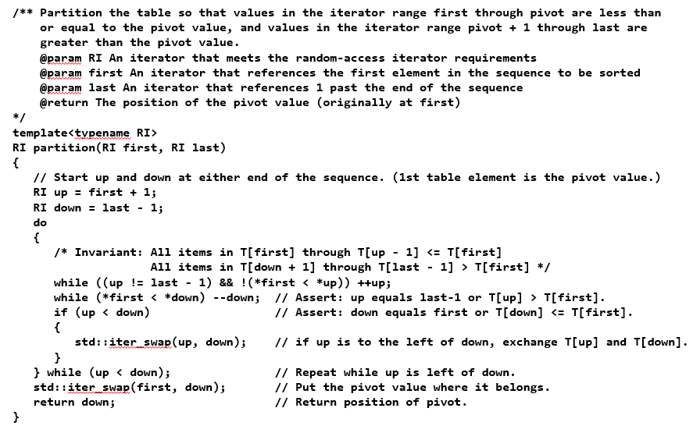
Code for partition

Slide 104
A Revised Partition Algorithm
Quicksort is O(n²) when each split yields one empty subarray, which is the case when the array is presorted.
The worst possible performance occurs for a sorted array, which is not very desirable.
A better solution is to pick the pivot value in a way that is less likely to lead to a bad split.
Use three references: first, middle, last.
Select the median of these items as the pivot.
Revised Partition Algorithm
1. Sort table[first], table[middle], and table[last-1].
2. Move median value to first position (pivot value) by exchanging table[first] and table[middle].
3. Initialize up to first + 1 and down to last - 1.
…

Slide 105
A Revised Partition Algorithm

Slide 106
Median of Three
first
middle
last
44
75
23
43
55
12
64
77
33
middle = (last – first) / 2
= (8 – 0) / 2 = 4

Slide 107
Median of Three
first
middle
last
33
75
23
43
44
12
64
77
55
Sort these values

Slide 108
Revised Partitioning
first
middle
44
75
23
43
33
12
64
77
55
Exchange middle and first

Slide 109
Revised Partitioning
up
down
44
75
23
43
33
12
64
77
55
Run the partition algorithm using the first element as the pivot

Slide 110
Revised Partitioning
up
down
44
75
23
43
33
12
64
77
55
up moves right until > 44
down move left until <= 44

Slide 111
Revised Partitioning
up
down
44
12
23
43
33
75
64
77
55
then exchange and
continue until down <= up

Slide 112
Revised Partitioning
down
up
44
12
23
43
33
75
64
77
55
When down and up cross…

Slide 113
Revised Partitioning
down
up
33
44
44
12
23
43
33
75
64
77
55
Exchange first with down.
down becomes pivot.
Recursively Quicksort
{ 33, 12, 23, 43 }
Then recursively Quicksort
{ 75, 64, 77, 55 }

Slide 114
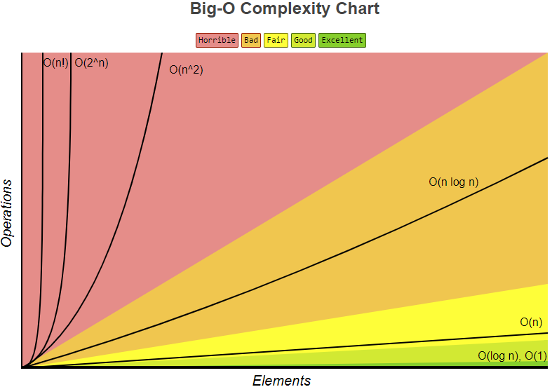
 | Best | Average | Worst
Quicksort | O(n log(n)) | O(n log(n)) | O(n^2)
Mergesort | O(n log(n)) | O(n log(n)) | O(n log(n))
Heapsort | O(n log(n)) | O(n log(n)) | O(n log(n))
Bubble Sort | O(n) | O(n^2) | O(n^2)
Insertion Sort | O(n) | O(n^2) | O(n^2)
Selection Sort | O(n^2) | O(n^2) | O(n^2)
Shell Sort | O(n log(n)) | O(n(log(n))^2) | O(n(log(n))^2)
But because Quicksort has the best performance in the average case for most inputs, it is generally considered the “fastest” sorting algorithm.

Slide 115
Be Safe

